Slide 1


Food Sales Predictions
A modeling approach to understand how to increase food sales

Slide 2

Agenda
Project Overview
Exploratory Data Analysis
Modeling
Results
Conclusions

Slide 3
Project Overview
Project description
Technologies to Accomplish objective
Objective is to increase retail outlet sales
Develop machine learning approach to understand product and retail features that drive sales
Deploy strategies around the most relevant features
Python programming language
Machine learning using regression algorithms to predict outlet sales
Multiple models to best understand how price predictions relate to important features

Slide 4
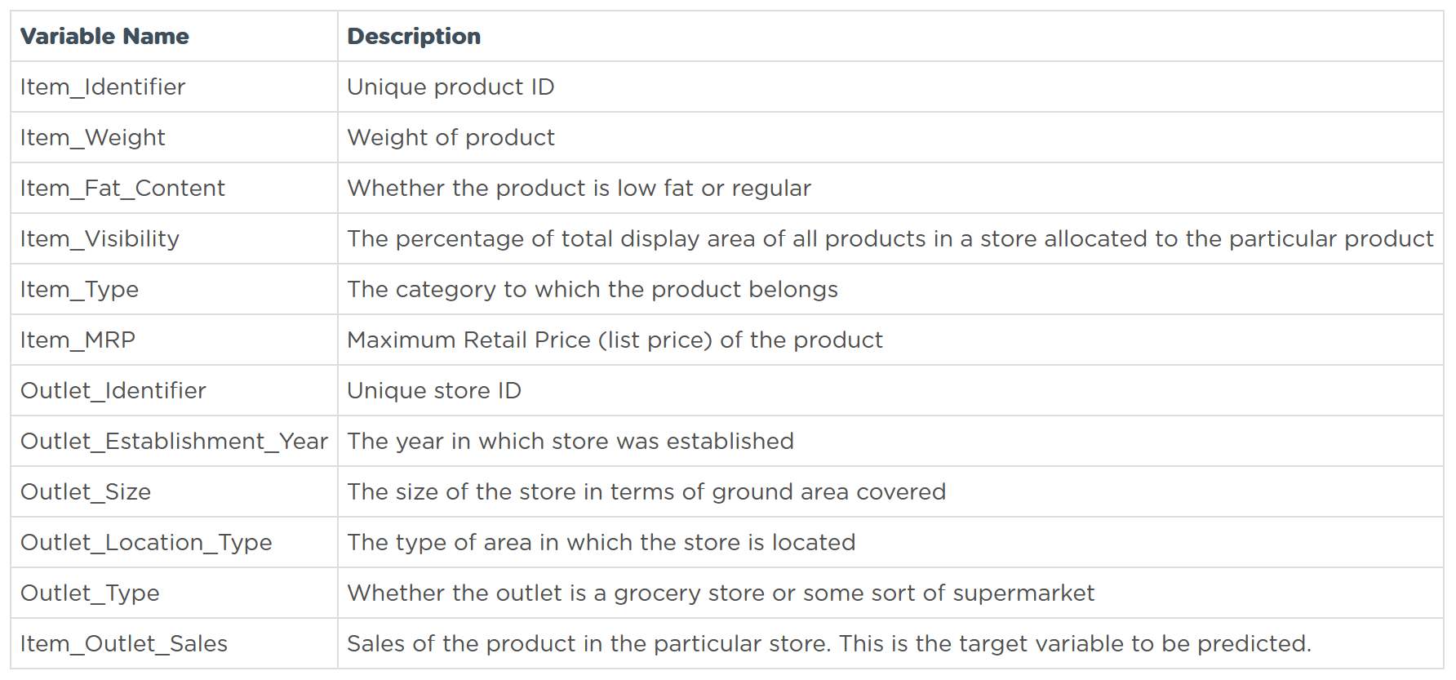
Exploratory Data Analysis (EDA) & Cleaning
Exploratory Data Analysis
Explore dataset to understand
Structure
data types
possible trends among observations and variables
Data cleaning
drop null values
Remove duplicate observations
Infer missing data if possible
Irregular spelling
Data Dictionary

Slide 5
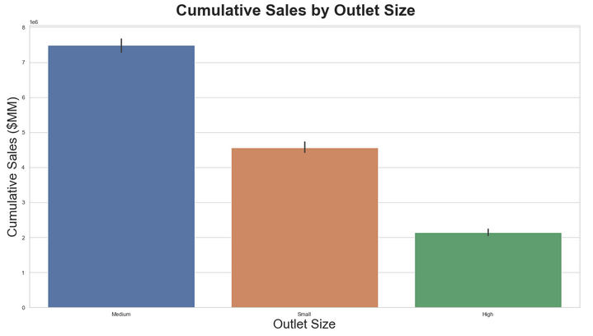
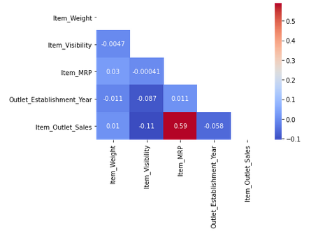
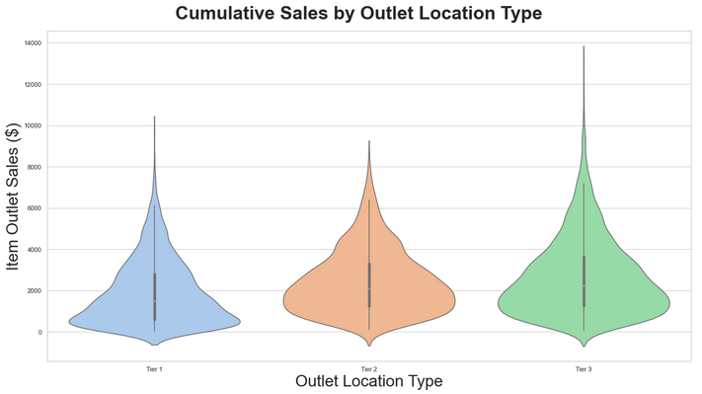
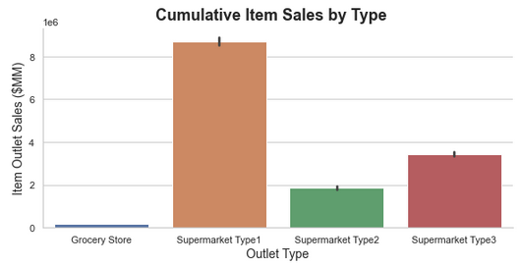
EDA – Data Visualization
Trends In the data
Item MRP is most correlated to Item Outlet Sales
Categorical data
Outlet size
Outlet type
Outlet location type

Slide 6
Modeling
Model Setup
EDA revealed ordinal relationships in data
Data is not strongly correlated
Use a regression model to predict Item Outlet Sales
Feature engineering
One-hot encode categorical data
Item Fat Content
Item Type
Label encode ordinal data
Outlet Size
Outlet Location Type
Outlet Type
Deployed Models
K Nearest Neighbors Regression
Range of k values
Bagged Trees Regression
Range of estimators
Random Forests Regression
Range of estimators

Slide 7
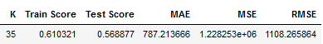


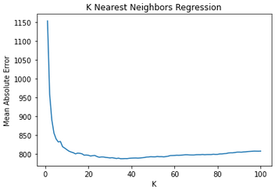
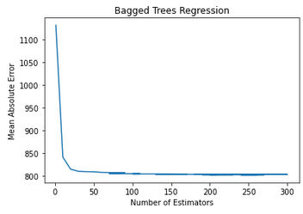
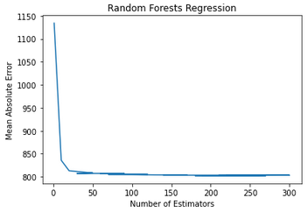
Results
K nearest neighbors
Bagged trees
Random forest
best performance k = 35
mean abs error = $787
crucial features
Item MRP, Outlet Size, Outlet Location, Outlet Type
best performance with 260 estimators
mean abs error = $ 801
crucial features
Item MRP, Item Weight, Outlet Type, Outlet Location Type, Outlet Size
best performance with 200 estimators
mean abs error = $802
crucial features
Item MRP, Item Weight, Outlet Type, Outlet Location Type, Outlet Size

Slide 8
Conclusions
Results Interpretation of Sales Drivers
Item MRP is the biggest sales driver
Item weight has some effect on sales
Store type can drive sales volume
The area where a store is located affects sales volume
Pricing Strategies
Adjust MRP to maximize outlet sales
Location Strategies
Research areas where stores are located
Research customer reaction to store type

